Slide 1

MES 503 Lab 5
Kayla Blincow, PhD

Slide 2

Announcements
Lab assignment 2 posted on Brightspace
  Due next Wednesday
Quiz 2 next Monday
Share papers with me please ☺

Slide 3
t-tests!
When do we use them?
What type of data is our explanatory variable?
What type of data is our response variable?

Slide 4

t-Test
Used to test for differences between two means
Different types:
  One sample
  Two sample
  One-tailed
  Two-tailed
Type depends on your question and hypothesis
Null distribution – Student’s t distribution
Test statistic – t test statistic (what you’re calculating to compare against the distribution)

Slide 5
t-Test Assumptions
Your sample means are normally distributed
Depending on type:
  Assumption of equal variance between sampled populations (exception two sample t-test for unequal variance)
  Assumption of independence between sampled groups (exception paired t-tests)
t tests are generally robust to violations of assumptions

Slide 6
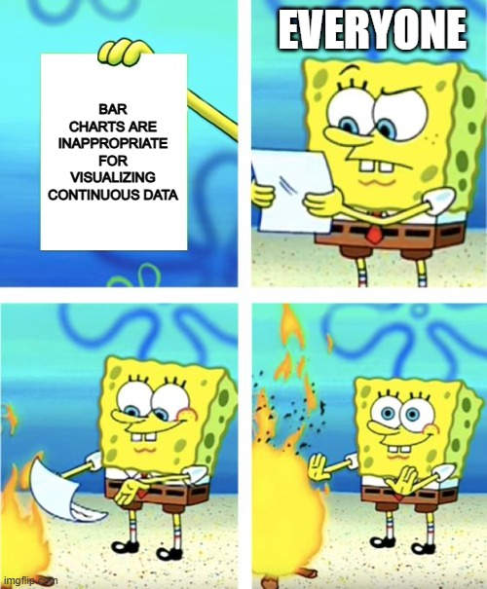
Side quest…
BAR PLOTS ARE NOT MEANT FOR DISPLAYING CONTINUOUS DATA OR MEANS.

Slide 7
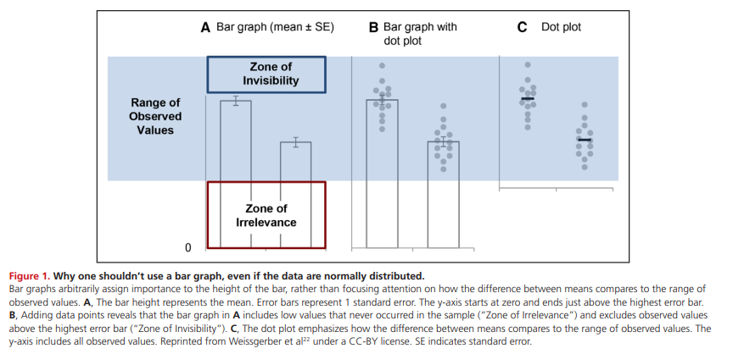
Weissberger et al. (2019)
We will discuss lots more later when we talk about data sheet and figure design.

Slide 8
Switch to ze code!

